Slide 1

3D-Reconstruct with Kinect
18-799 Final Project
Li Pei(lip) & Yiming Zhang(yimingz2)

Slide 2
Introduction
3D Model Reconstruction is of great meaning in modern society
However, modern large scale 3D scanners
expensive
lack mobility
need to be controlled by professionals
Inspiring us to build a 3D reconstruction method with
relatively low cost
better mobility
moderate accuracy
Notes:
3D model reconstruction is of great significance in modern society. However, the 3D scanners so far are just for professionals, which inspired us to build a 3D reconstruction method which cost less with better mobility and moderate accuracy.

Slide 3
Introduction
Idea:
Use Kinect to combine depth info and RGB info
Take picture with Kinect for both sides
Splice the pictures
Form the surface
Reconstruct 3D figure
Notes:
Our project idea is to use Kinect to combine depth info and RGB info. Take pictures for both sides of the model. Combine the information of both sides and reconstruct the 3D figure.

Slide 4
Approaches
Getting Depth and RGB image with Kinect
Extract foreground in Kinect Depth Image Output
Building 3D Coordinate with Depth Image
Present the Point Cloud
Splice Point Cloud of Different Surfaces
Triangulation
Notes:
Here are our mainly approaches.

Slide 5
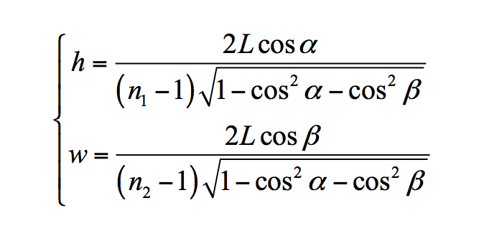
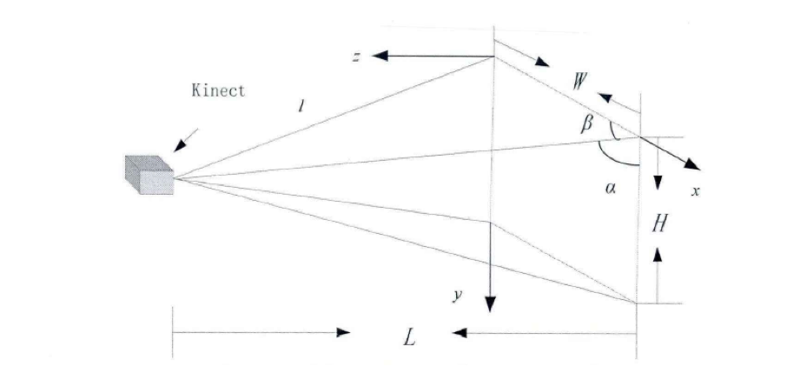
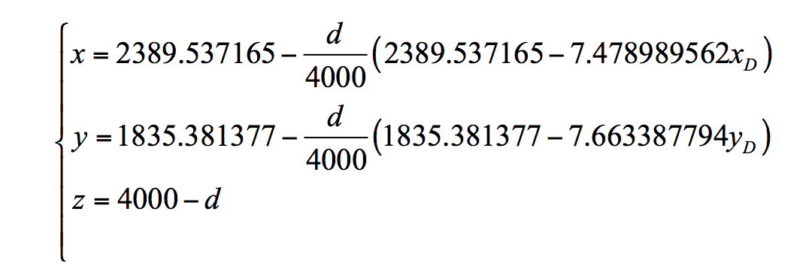
Approaches- Getting Cordinates
Notes:
The sight of kinect is a pyramid. However, we need to reconstruct the information in a rectangular area. Therefore, here we deduced a projection function, which is shown in the slide. With this, we can get the depth and RGB information in a rectangular space.

Slide 6
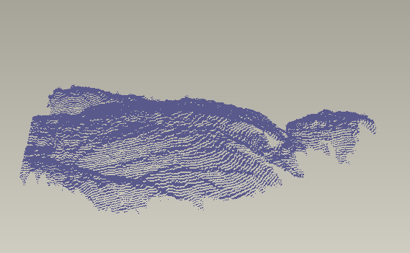
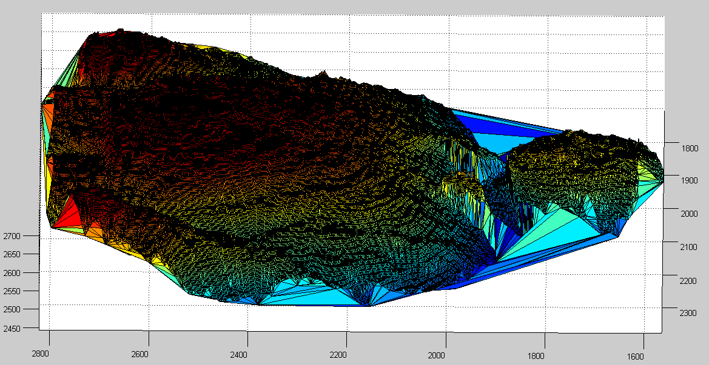
Approaches - Triangulation
Point Cloud
Triangulation Result
Notes:
From the processing so far, we have all the information on points. Here, we use two triangulation method, namely MyCrust and Delaunay, to form the surface of the model.

Slide 7
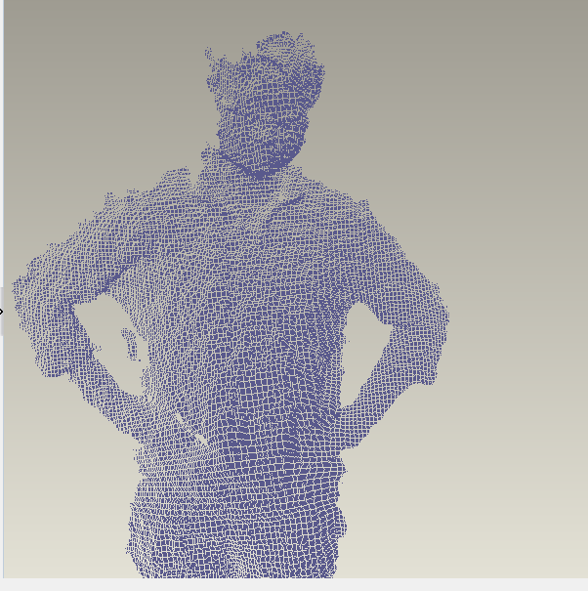
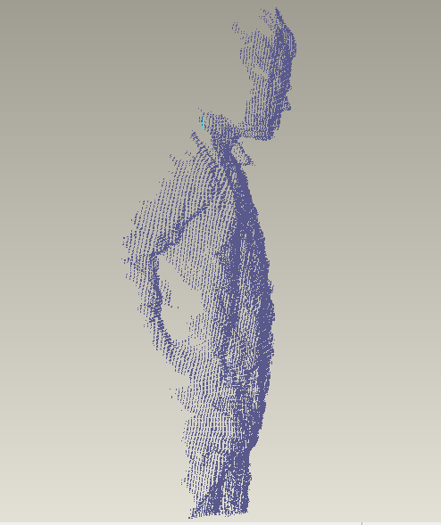
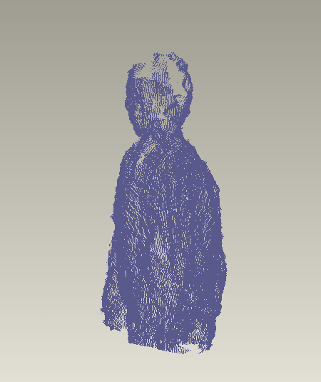
Results-Point Cloud
Front Point Cloud in Pro/Engineer
Spliced Point Cloud in Pro/Engineer
Notes:
Here’s the output result of point cloud, displayed in Pro/Engineer.

Slide 8
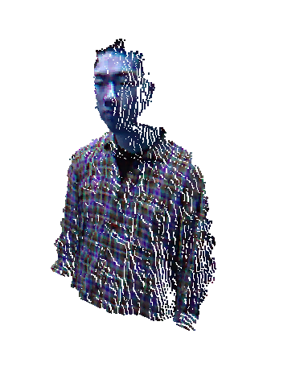
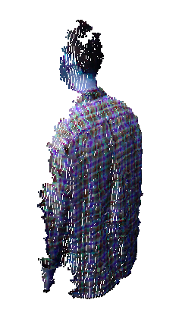
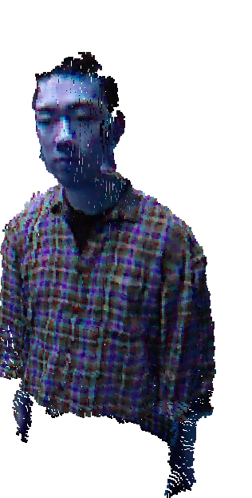
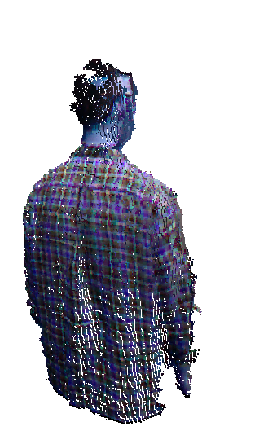
Results-Point Cloud with RGB info
Front/Back Point Cloud with RGB info
Spliced Point Cloud with RGB info
Notes:
Here’s the result of point cloud with RGB information on it.

Slide 9
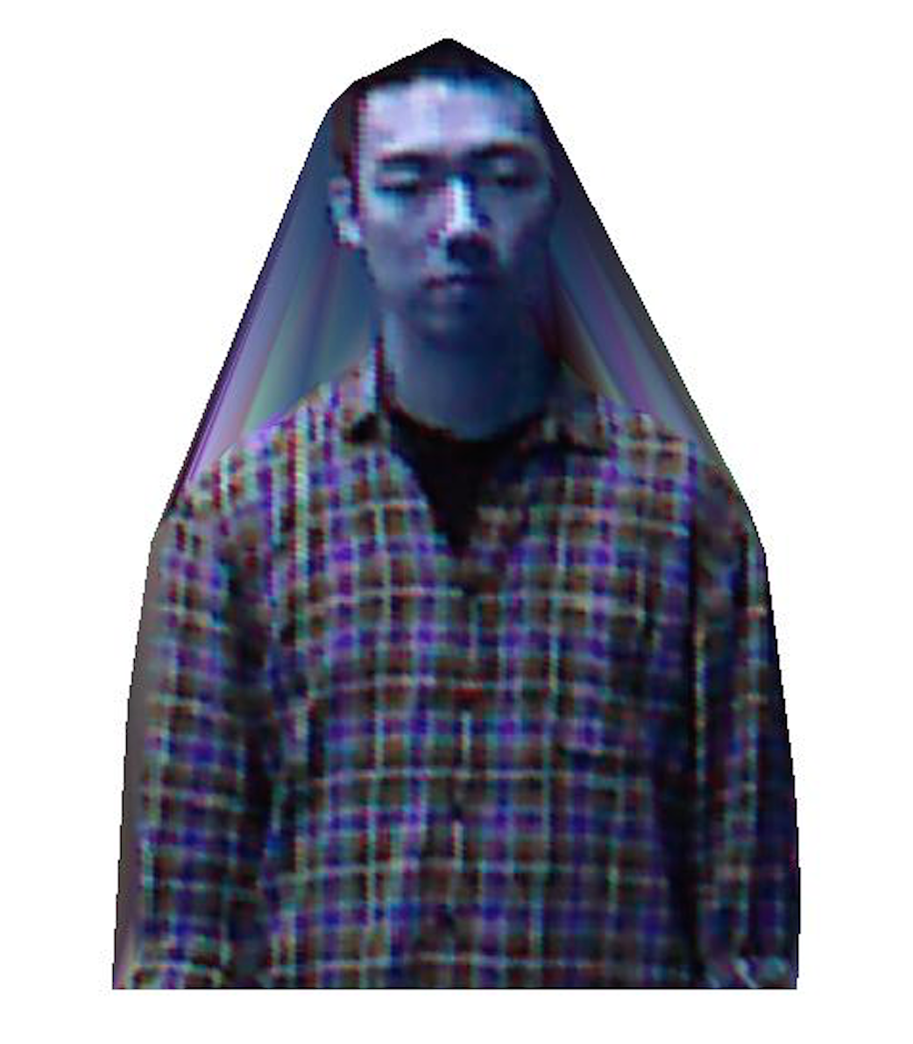
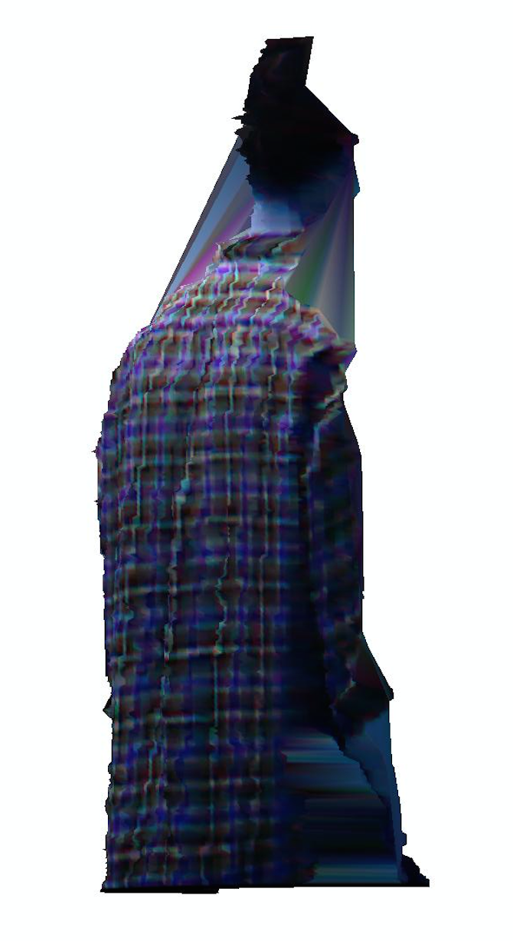
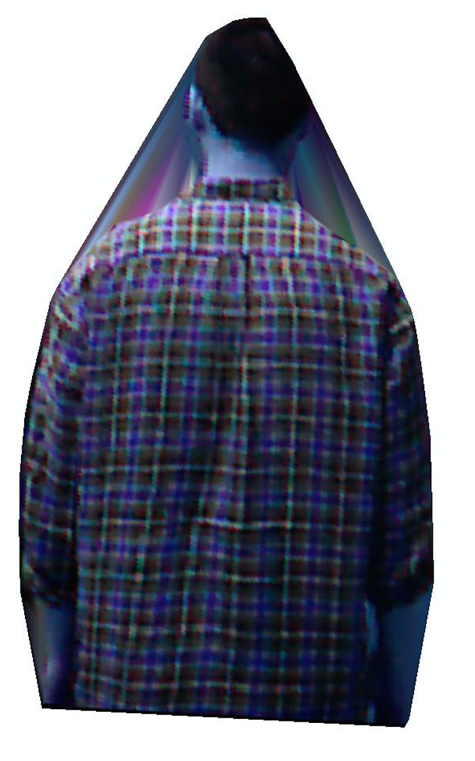
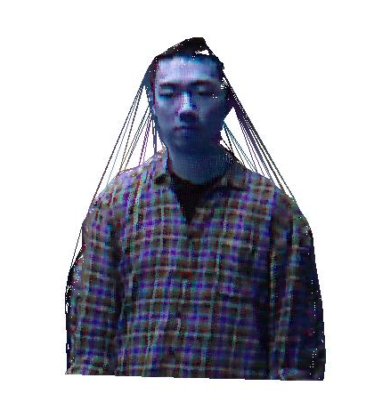
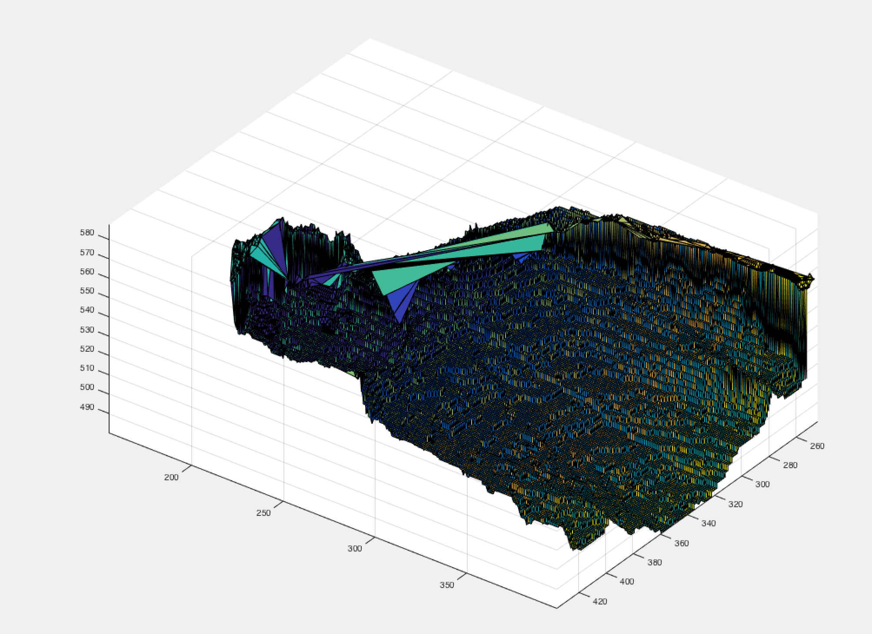
Results-Triangulation with Delaunay
Front/Back triangulation with RGB info
Spliced triangulation with RGB info
Notes:
Here’s the result of triangulation with Delaunay.

Slide 10
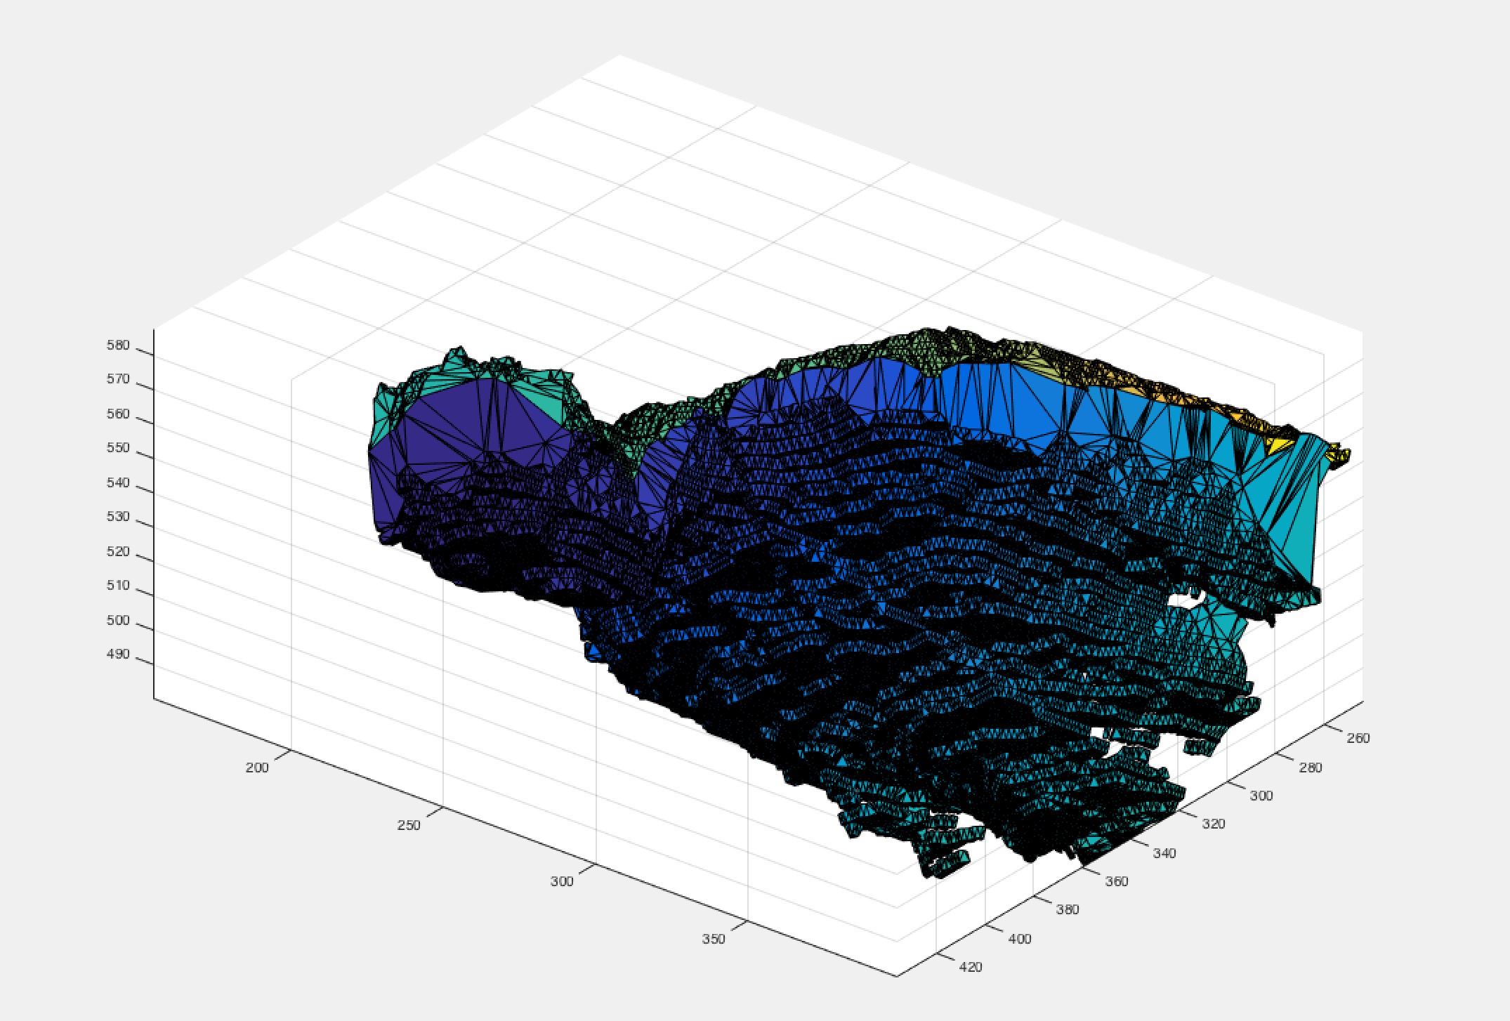
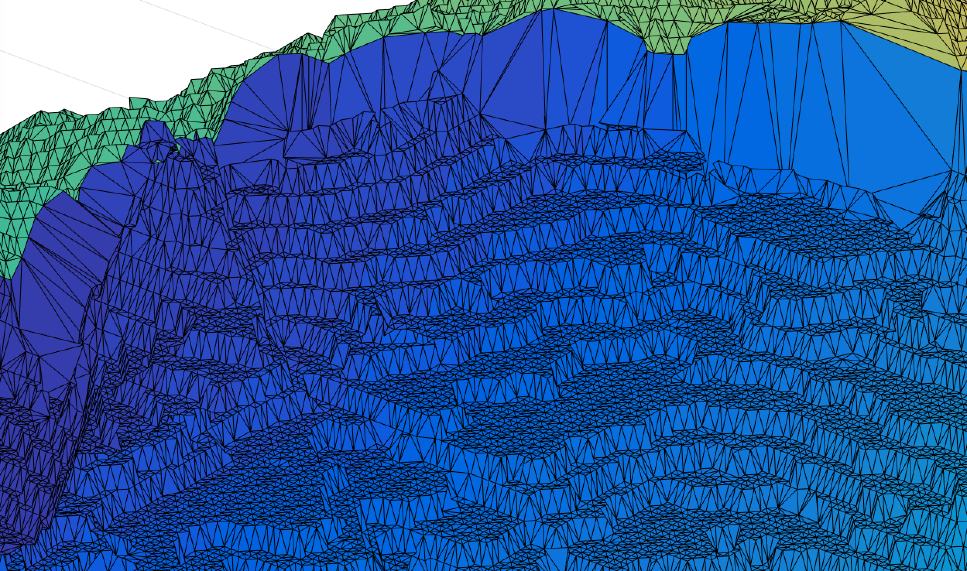
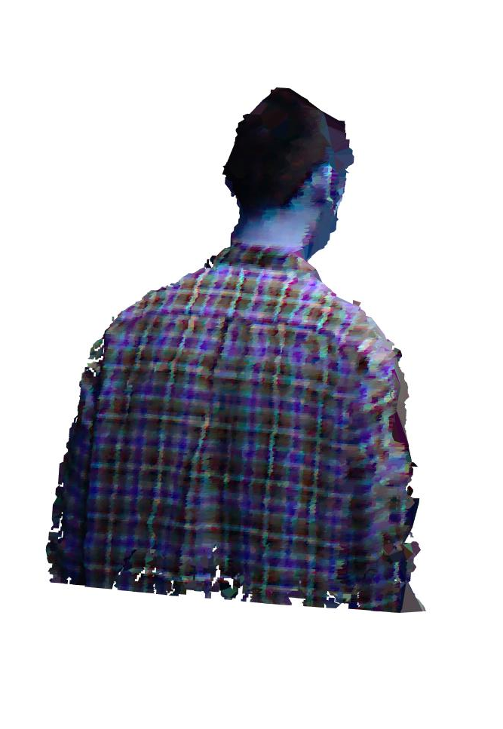
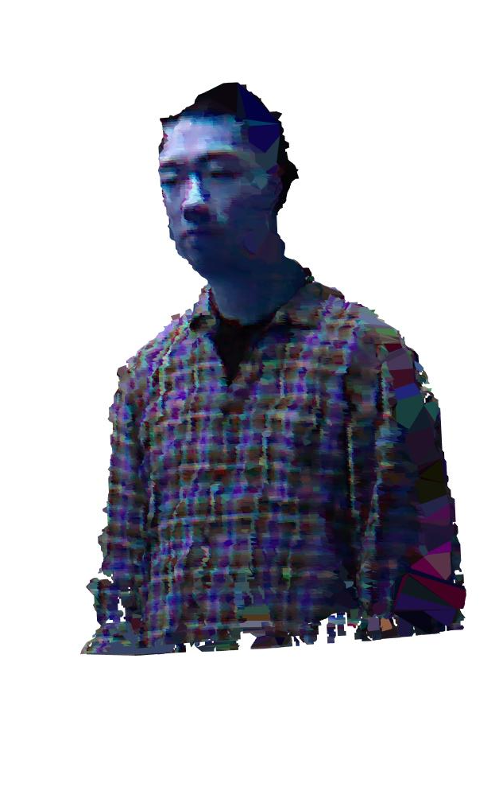
Results-Triangulation with MyCrust
Triangulation with MyCrust
Triangulation in detail view
Spliced triangulation with RGB info
Notes:
Here’s the result of the triangulation with MyCrust.

Slide 11
References
1. B. Curless and M. Levoy. “A volumetric method for building complex models from range images,” In Proceedings of the 23rd annual conference on Computer graphics and interactive techniques (SIGGRAPH). New York, NY, USA, pp.303-312, 1996.
2. Z. Zhang, “Digital Photogrammetry and Computer Vision,” Geomatics and Information Science of Wuhan University, issue 12, pp.1035-1039, 2004.
3. Nakagawa M. “Integrating high resolution air-borne linear CCD (TLS) imagery and LIDAR data,” 2nd GRSS/ISPRS Joint Workshop on Remote Sensing and Data Fusion over Urban Areas, pp. 236 – 240 2003.
4. M. Liao, Q. Zhang, H. Wang, R.Yang, M. Gong, “Modeling deformable objects from a single depth camera,” IEEE 12th International Conference on Computer Vision, pp.167-174, 2009.
5. C. Daniel Herrera, Juho Kannala, Janne Heikkila. Accurate and Practical Calibration of a Depth and Color Camera Pair[J]. Computer Analysis of Images and Patterns, vol.6855, pp.437-445, 2011.
…

Slide 12
Thank You
Notes:
Thank you for your time and attention!

